Slide 1
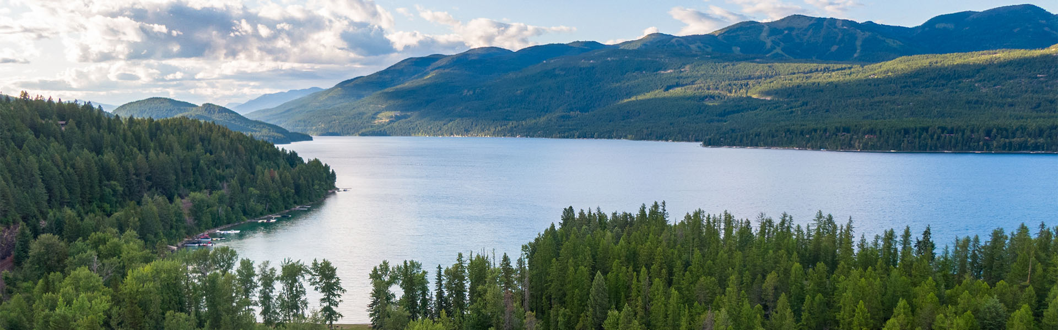
MSDI Cadastral Working Group
Whitefish Lake
Photo credit: FWP
May 19, 2026 | 10:00 – 11:30am

Slide 2
Presentation Overview
Welcome & Introductions
Overview of the Data Quality Improvement Matrix & Plan
Cadastral Data Quality Improvement Plan
Discussions
Cadastral Framework Them Updates (if time allows)
Closing (On the Horizon/Next Steps)

Slide 3
Introductions
Name
Agency you Representation
(optional) Favorite Montana Cadastral feature
~ could be a building, public park, campground or water of body

Slide 4
Overview of the Data Quality Improvement Matrix & Plan

Slide 5
Overview of Assessing MSDI Framework Data
MSL's GIS Coordination Strategic Plan (FY2023-2027)
  Prioritized four Business Plans
Goal 4: Business Plan to Improve Geospatial Data Value
  "Improve the collection, maintenance, and dissemination of authoritative geospatial information, aiding the creation of better policies, more informed decisions, and providing value to Montana."
  Objective 3:
    "Assess datasets and data themes using the data quality measures"
  Objective 4:
    "Determine actions needed to improve the value of the selected datasets and data themes"
  Objective 5:
    "Generalize the findings in Objective 4 to a program of data quality improvement"

Slide 6
Data Quality and Improvement Process
Objective 1
Objective 3
Objective 5
Define MSDI Datasets &
Data Themes
Assess Datasets/Themes using Data Quality Measures (matrix)
Generalize the findings in Objective 4 to a
Program of Quality Improvement
Objective 2
Objective 4
Define measures of Geospatial Data Value for those Datasets/Themes
Determine Actions needed to improve the value of selected Datasets/Themes (plan)

Slide 7
Assessing MSDI Framework Data
Data Quality Measures
Update Frequency
Archive Frequency
Accuracy/Precision
Consistency
Completeness
Integrity
Business Relevance
For each measure, consider current practices, short-term needs, and long-term needs.​

Slide 8
Data Quality and Improvement Process
Objective 3: Assess Datasets/Themes using Data Quality Measures (Matrix)
Uses the data quality dimensions to assess the data themes
Create worksheet (matrix) for each theme / sub-theme
Data Themes/Sub-Themes are listed in Rows
Data Quality Dimensions are listed in Columns

Slide 9
Data Quality and Improvement Process
Objective 4: Determine actions needed to improve value of Datasets & Themes (Plan)
Actions needed to address deficiencies and make improvements
Actions will differ by dataset & data theme
Technical means and Tools that will be used
Common Technical Means:
  Performing consistent data profiling to determine missing values, outliners, etc.
  Implementing proactive data validation during entry and editing workflows
  Using plan that specifies who, when, and how datasets are updated
  Establishing and enforcing standards (domains, constraints, naming conventions, etc.
  Promulgating standards and educating data creators/maintainers to build culture

Slide 10
Data Quality and Improvement Process
Objective 5: Generalize the findings in Objective 4 to a Program of Data Quality Improvement
1 – Assign priorities to the data themes
2 – Convene a data theme working group
3 – Sent a recurring schedule of meetings
4 – Set schedule of data quality check-ins once plan is developed
5 – Define datasets included in the data themes to include in assessment
6 – Identify and document data owners, maintainers, consumers for selected dataset and data themes

Slide 11
Review of Cadastral Data Quality Improvement Plan

Slide 12
Summary of Findings
There is no direction in identifying areas in need of adjusting
The theme is on an *82-year path of “desired collection” be completed & adjusted
(a) There are over two dozen missing BLM surveys (from being entered)
(b) There are thousands of missing COGO survey lines
Parcels at the County Boundary are not seamless
Public Lands dataset has a significant number areas that are not seamless
The routing process for new Conservation Easements is far from ideal and sometimes leads to CEs to not be entered into Orion or the GIS
  * - this is an approximation based on the current pace the MSDI Mapping Control for receiving township corners & town/city vicinity collections

Slide 13
Near-Term Goals
Near-Term Goals
  Develop an evaluation metric to assist with identifying areas of need
  Availability of data in more formats on-demand and/or the ability to apply desired filters (ArcGIS Hub)
  Investigate how to make improvements to the Orion Data Service to ensure it returns the correct property information
  Publish parcels semi-monthly (combat large number of county split/combos)
  Complete metadata for all datasets
  Incorporate missing GLO surveys into the CadNSDI dataset
  Implement topology check to detect overlaps and gaps (public lands)
  Develop process to better detect ownership changes that impact public lands
  Work with providers to ensure the integrity needs of a seamless, statewide dataset are met (Ownerparcels)

Slide 14
Long-Term Goals
Near-Term Goals
Long Term Goals
  CadNSDI is complete, with missing surveys & survey lines all incorporated
  Acquire 35% of the control for every "surveyed" township corner of the state and make adjustments to those coordinates (10 year goal)
  Additional resources are made available to help users work with SQL databases more efficiently, reducing the learning curve
  Improvements made to routing process to ensure new Conservation Easements are entered into the GIS data in a more timely manner
  Public Lands dataset contains significantly less unintended gaps / overlaps (goal to have 75% of identified errors fixed)

Slide 15
Discussions
Feedback/Comment on Improvement Plan
Additional Improvement Ideas
Open Discussions
Questions

Slide 16
Cadastral Framework Updates

Slide 17
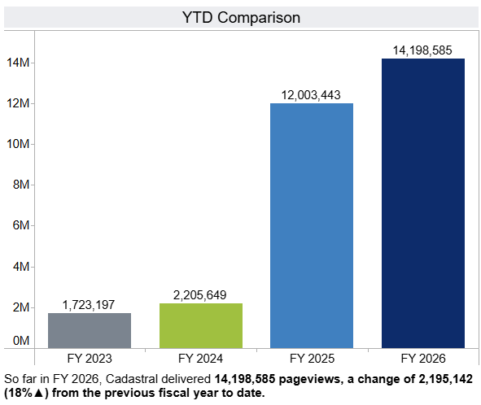
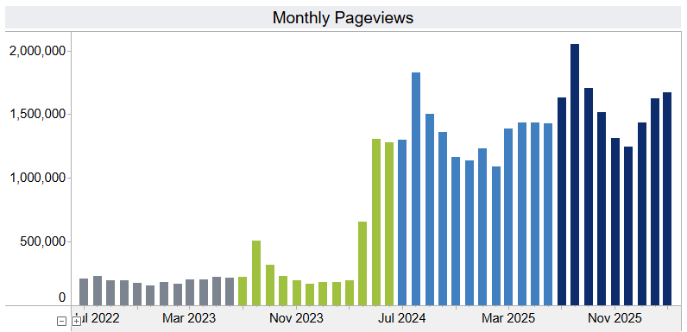
Cadastral Application Updates
Application page hits (views) are up over 2 million this fiscal year
Usage spike during beginning month of Property Tax Rebate
18% increase of usage this fiscal year compared to last year.
  This increase indicates the importance of the app across dozens of industries
This dashboard is available
  Below web address & then Montana Cadastral
  https://msl.mt.gov/about/publications/statistics/program-dashboards
https://msl.mt.gov/about/publications/statistics/program-dashboards

Slide 18
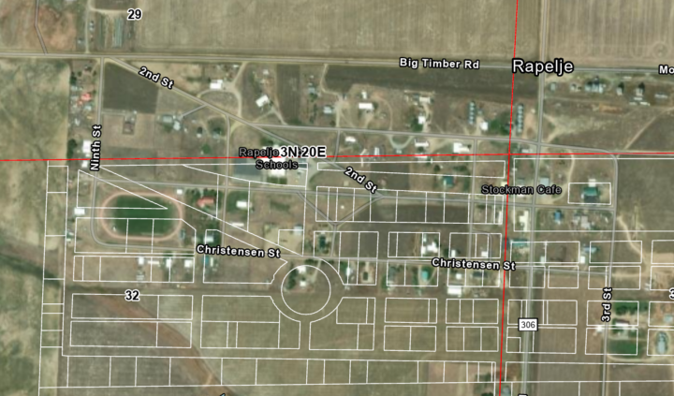
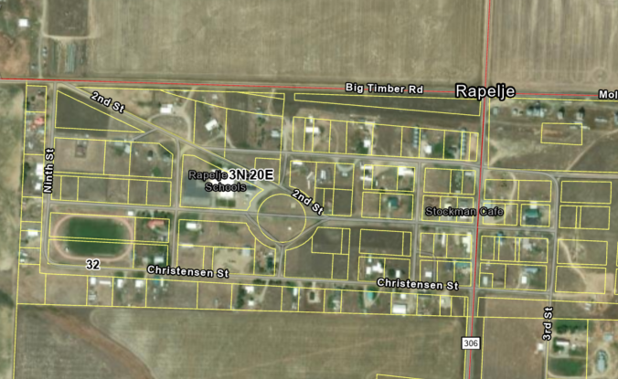
CadNSDI Updates
535 ft
Published in mid-March
  Available on FTP now
Changes in 24 different counties (between the last publication & this year’s)
Intersecting 420 PLSS Townships
Largest populated community adjustment ~ +500 feet (Rapelje, MT)

Slide 19
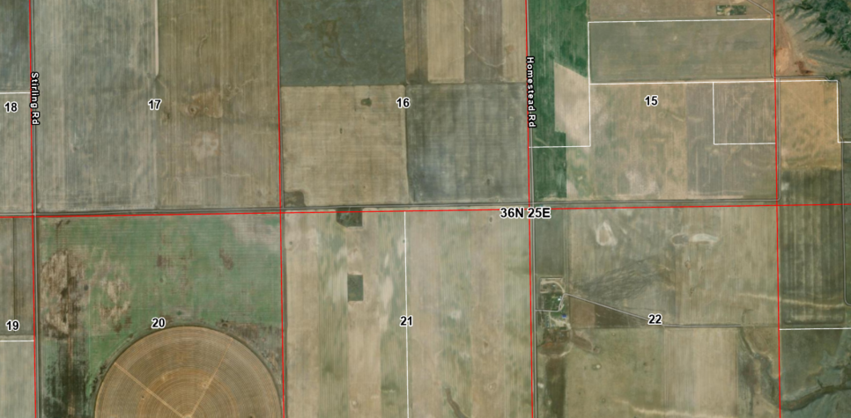
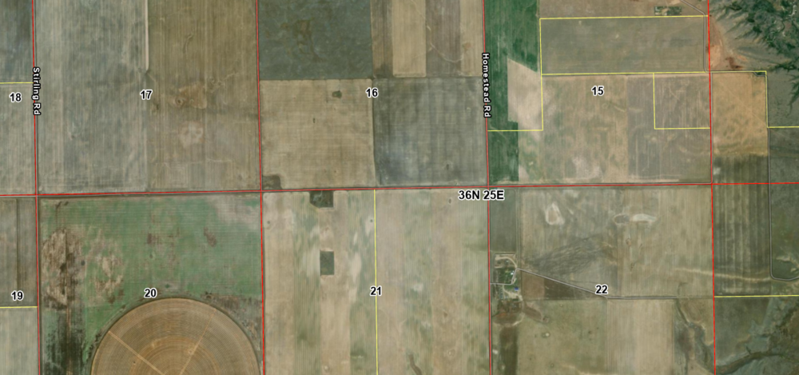
Adjustment Project Examples
130 ft
Blaine County – northwest of Turner

Slide 20
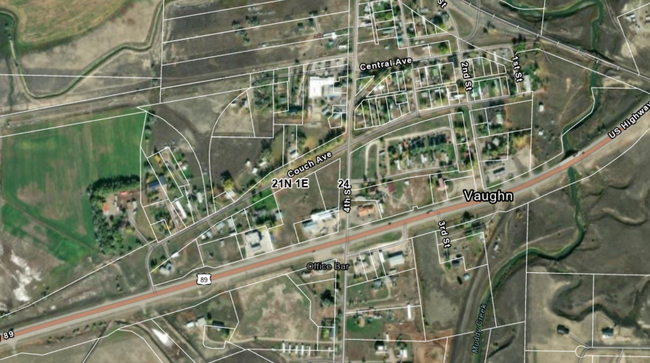
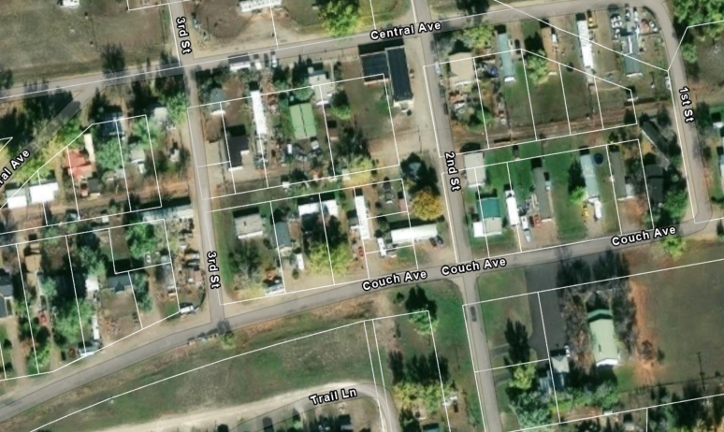
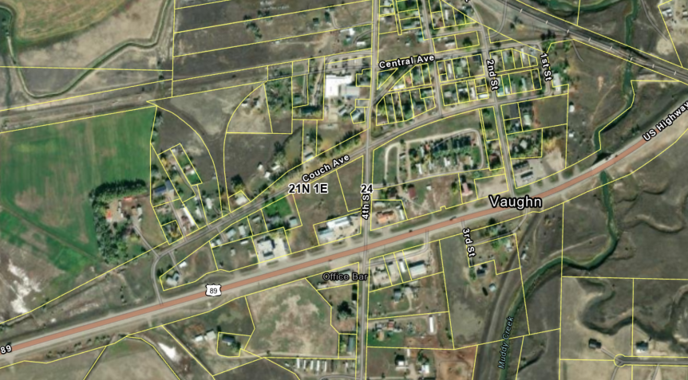
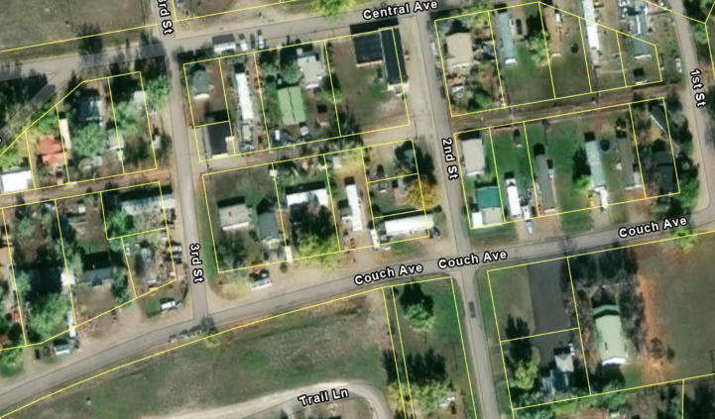
Adjustment Project Examples
50 ft
Cascade County – Town of Vaughn (west of Great Falls)

Slide 21
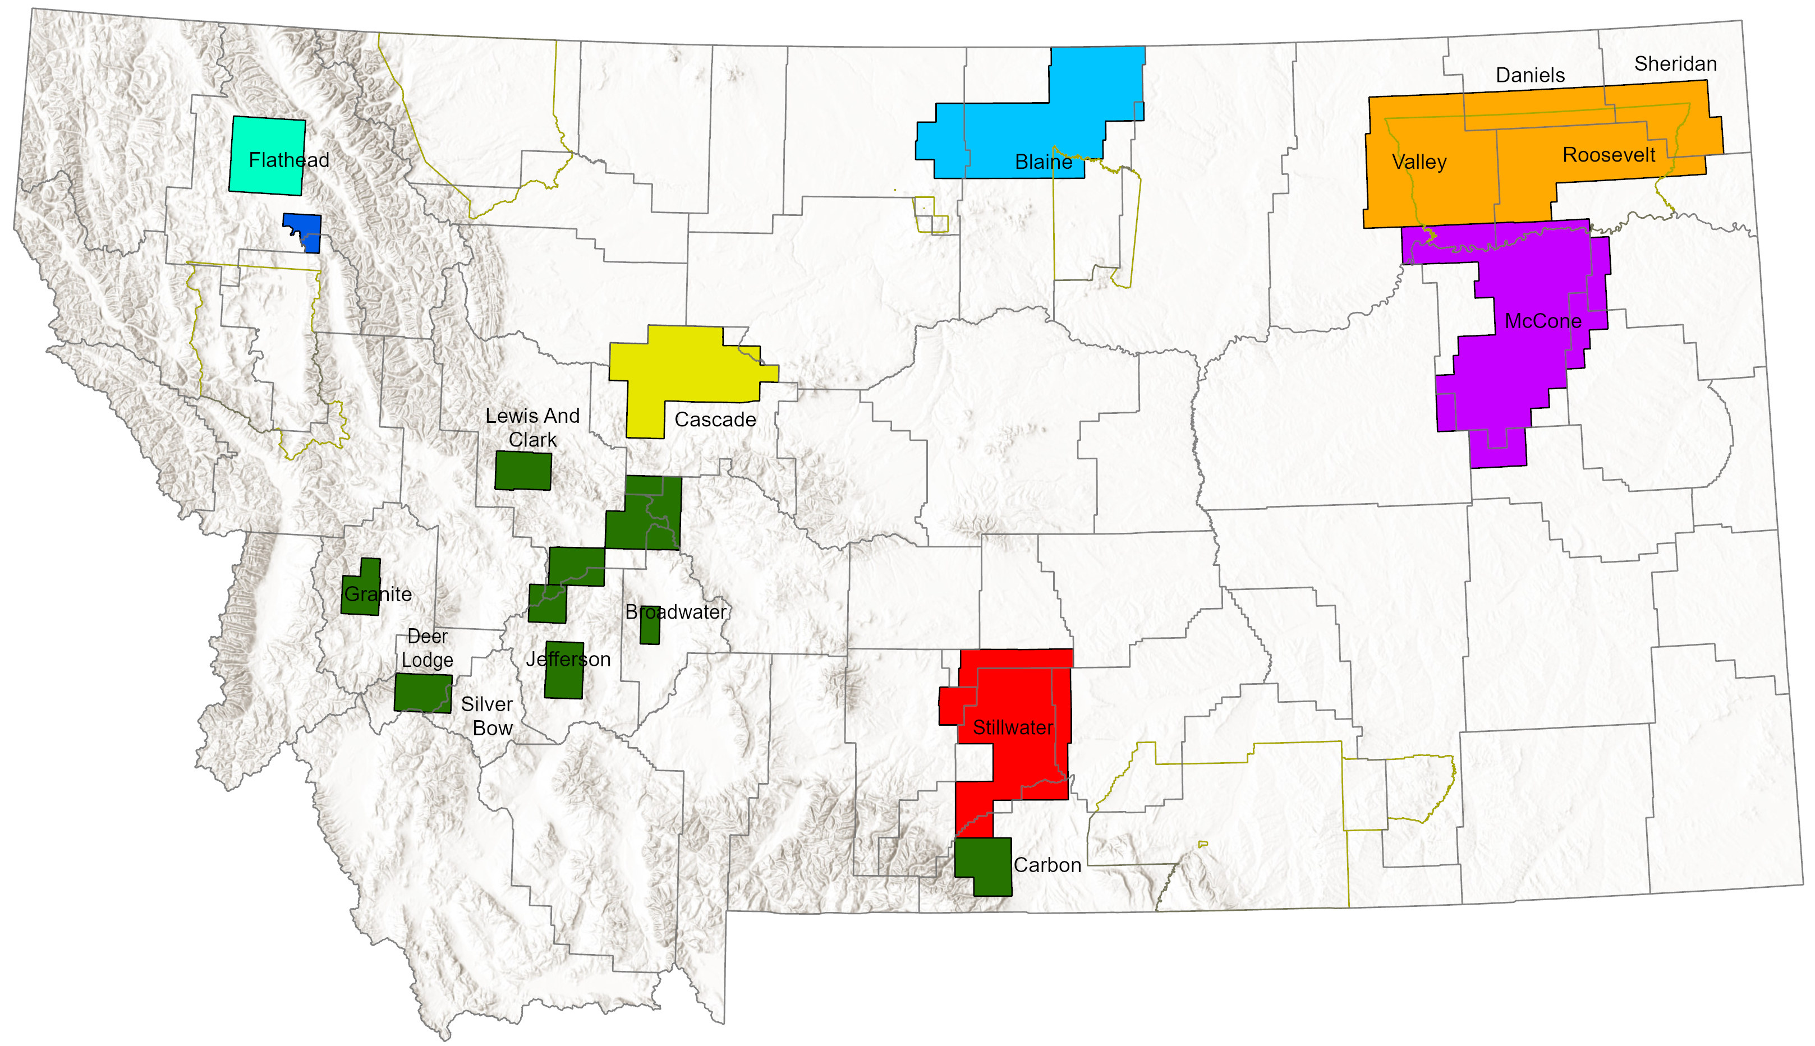
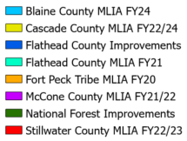
Successful Adjustments (2024-2026)

Slide 22
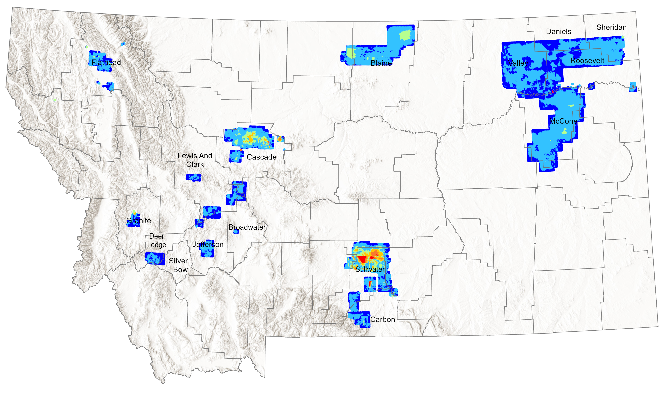
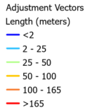
Adjustment Vectors (2024-2026)

Slide 23
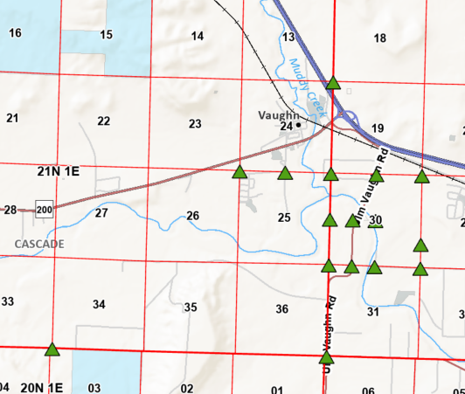
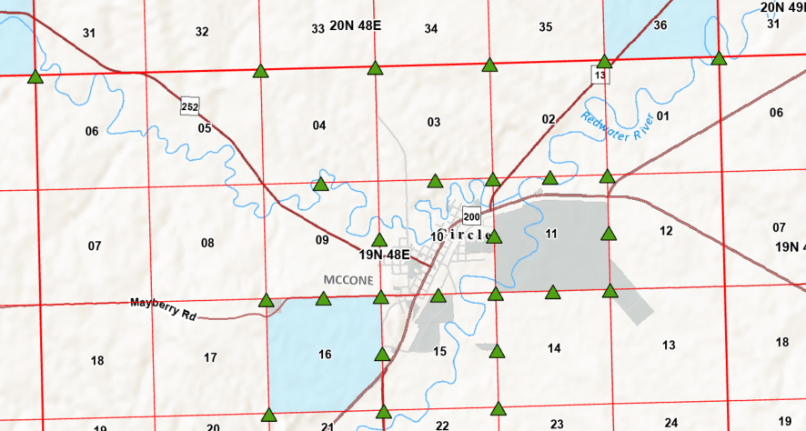
PLSS Control Imported
2024-26
Approx. 2,050 PLSS survey control imported into the parcel fabric
MDT was the top provider of control
Provider | Count
MDT | 853
MLIA/MGIA | 541
USFS | 490
BLM | 100
Private | 75
Notes:
Control Import Stats

Slide 24
Submitted Control to MSL
To date, most of the survey control for PLSS corners has been created through the MLIA/MGIA Granting program.
More recently the surveying community has been donating data.
MDT & Forest Service contribute a significant number of corners.
Figures to the right is PLSS control submitted January 2024 to present
Provider | Count
USFS | 1,391
MDT | 1,252
Kalispell City | 301
MLIA/MGIA | 151
Private | 140
Notes:
Control Import Stats

Slide 25
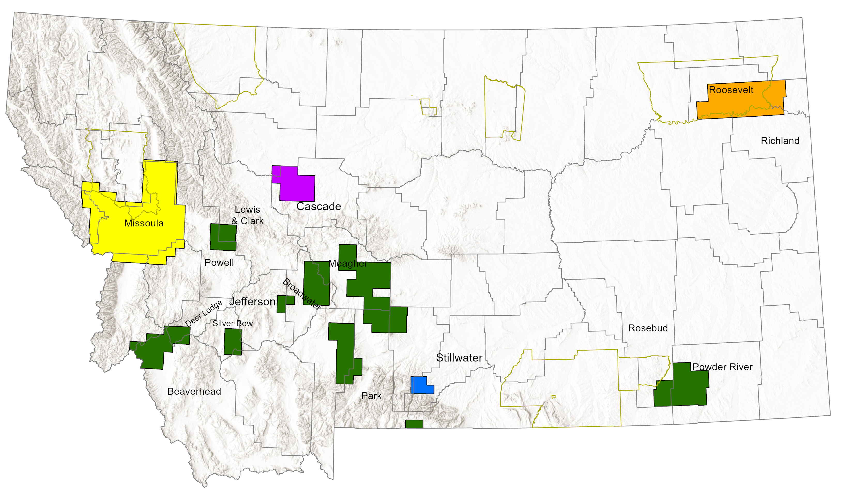

Upcoming Adjustments (2026-2027)

Slide 26

On the Horizon
Review Data Improvement Plan
  Feel free to email me additional comments
Next Cadastral Working Group will be this fall
Next Steps
  Incorporate feedback into the final Data Improvement Plan
  Present to MGIA Council
  Schedule next Working Group meeting to review draft Theme Plan

Slide 27
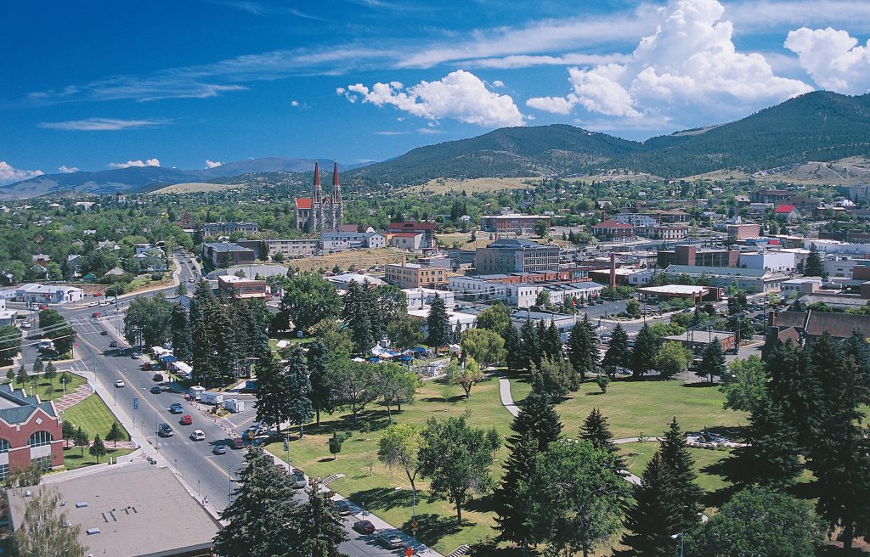
Questions?
Thank you for coming!
Please contact me:
Jeff Hedstrom
MSDI Cadastral Framework Theme Lead
jhedstrom@mt.gov | (406) 444-5371
https://msl.mt.gov/geoinfo/msdi/cadastral/
Subscribe to MSL News through GovDelivery for future meeting dates and other announcements:
https://public.govdelivery.com/accounts/MTLIBRARY/subscriber/new
Downtown Helena
Photo credit: Visit Southwest Montana

